Slide 1
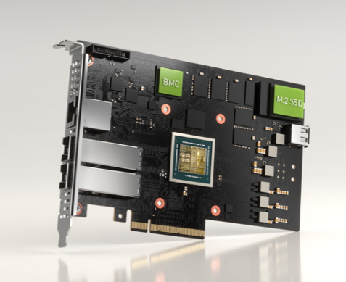
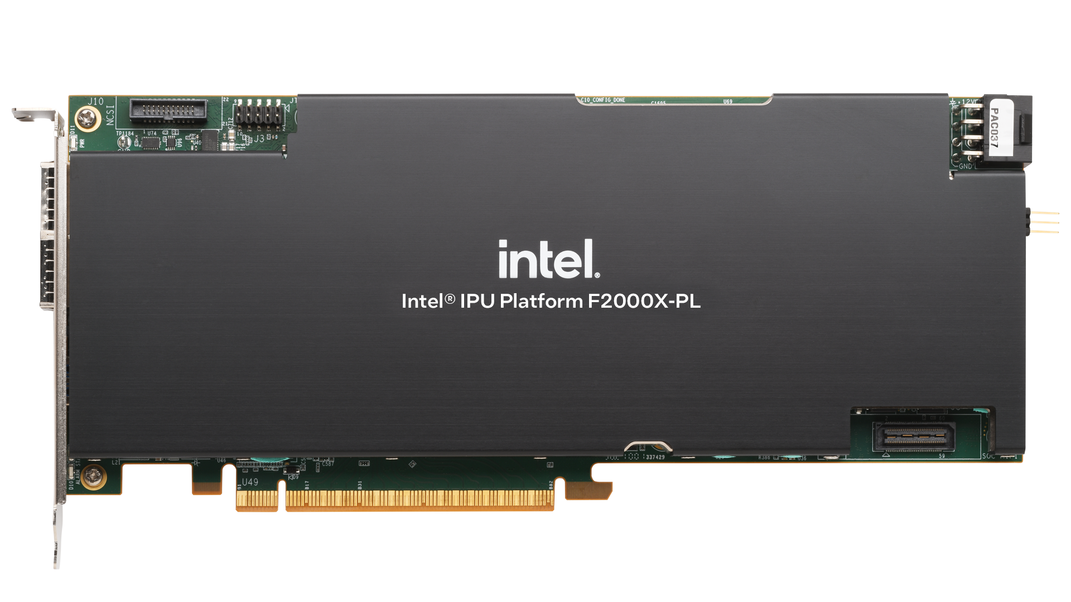

IPsec
Nvidia BlueField2/3
Intel Dayton Peak
Marvell CN106

